Slide 1
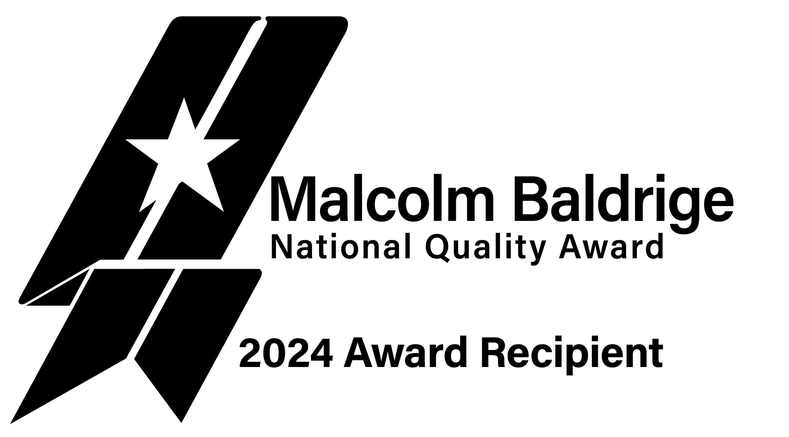

Northeast Delta Dental
Tom Raffio, President and CEO
March 31, 2025

Slide 2
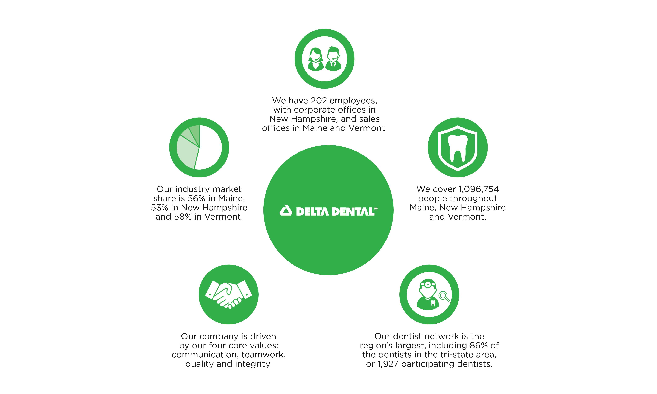
Slide 1

Slide 3
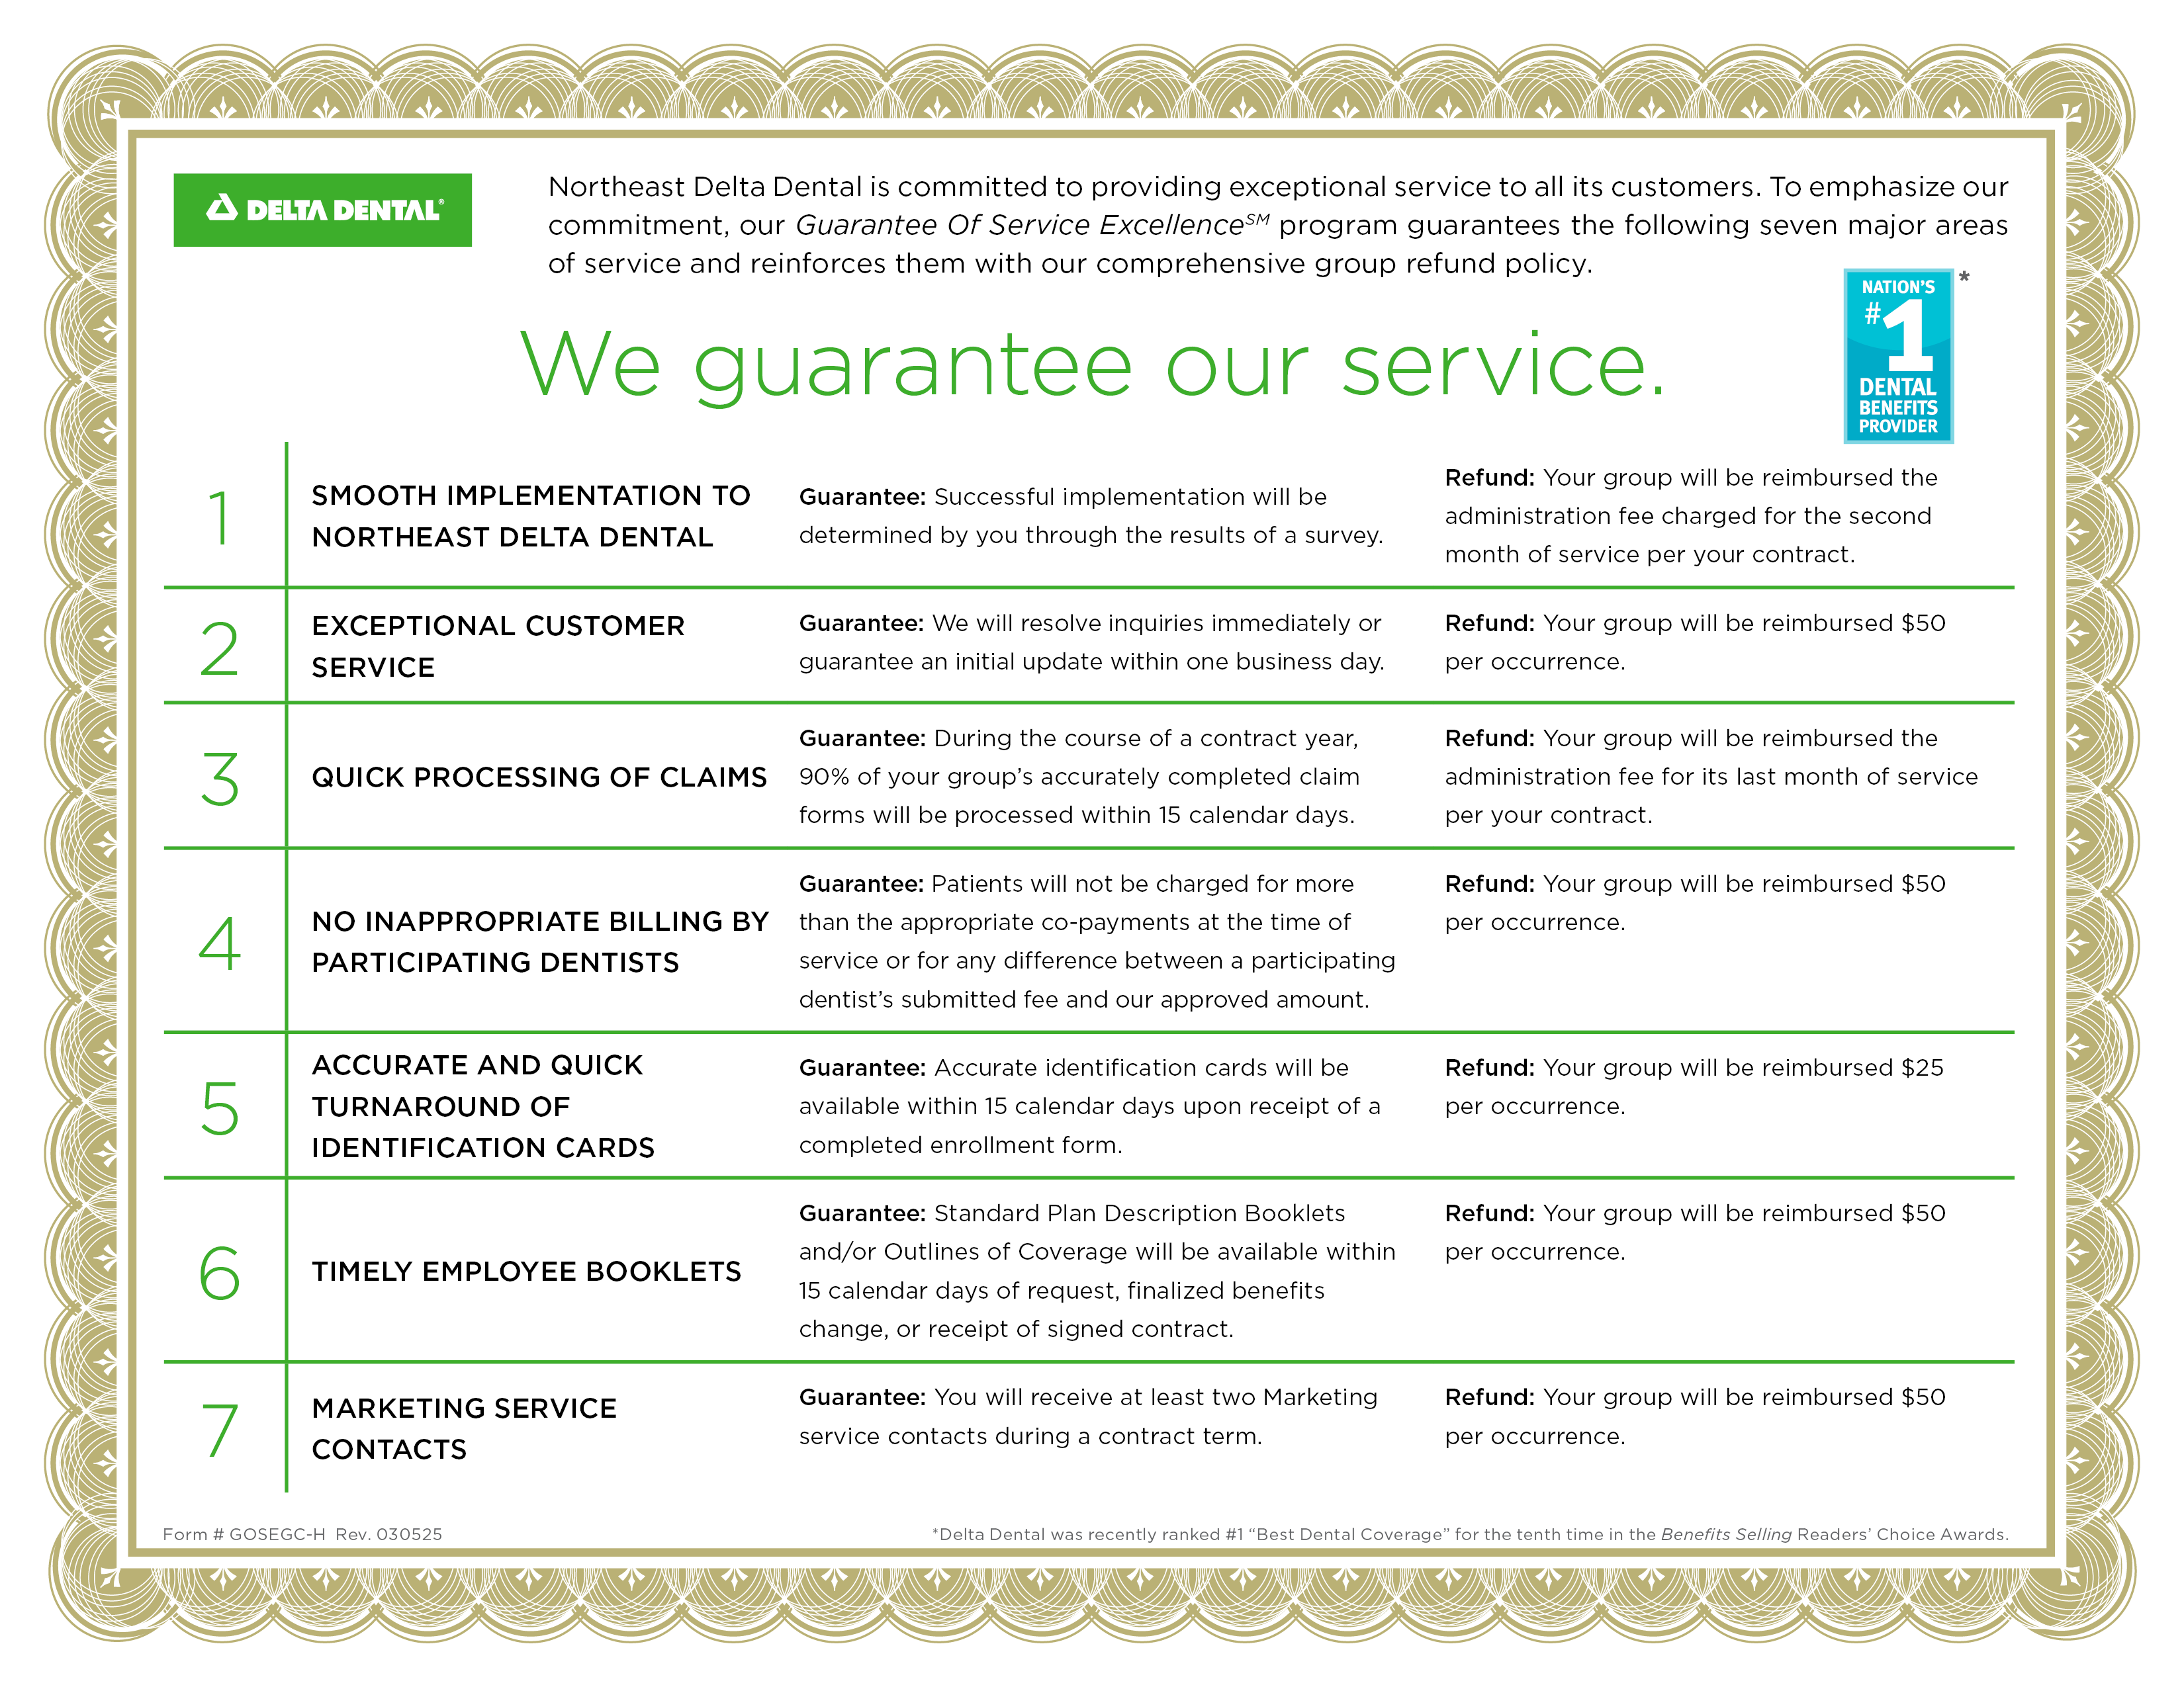
Slide 2

Slide 4
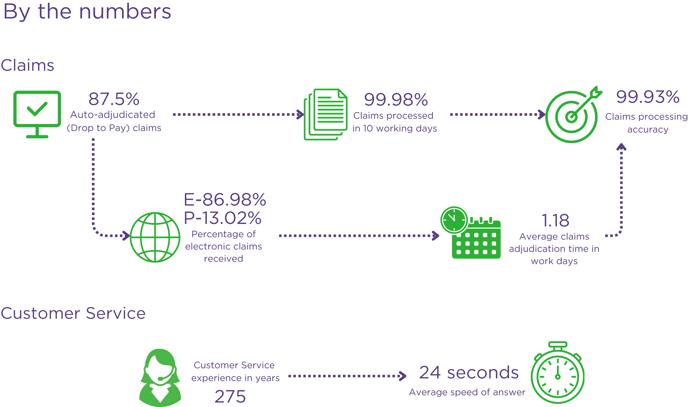
Serving participating dentists
Slide 3

Slide 5
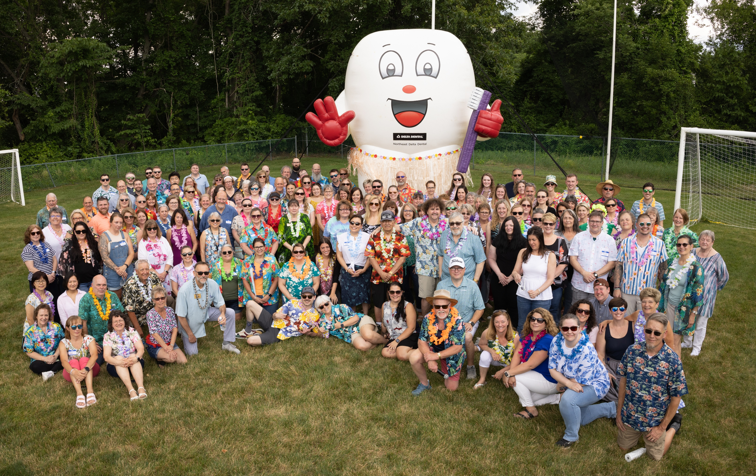

Slide 4

Slide 6

Markers for success
Customer focus
  Phones answered in an average of 24 seconds
  96% of calls resolved after the first contact
  Claims are adjudicated on an average of 1.18 days
  98% customer retention rate
Guarantee Of Service Excellence℠
Highly engaged workforce
Innovative use of technology
  Health through Oral Wellness®
Commitment to community
  Over $8 million contributed to community organizations in 2024
  Culture of excellence
Slide 5

Slide 7
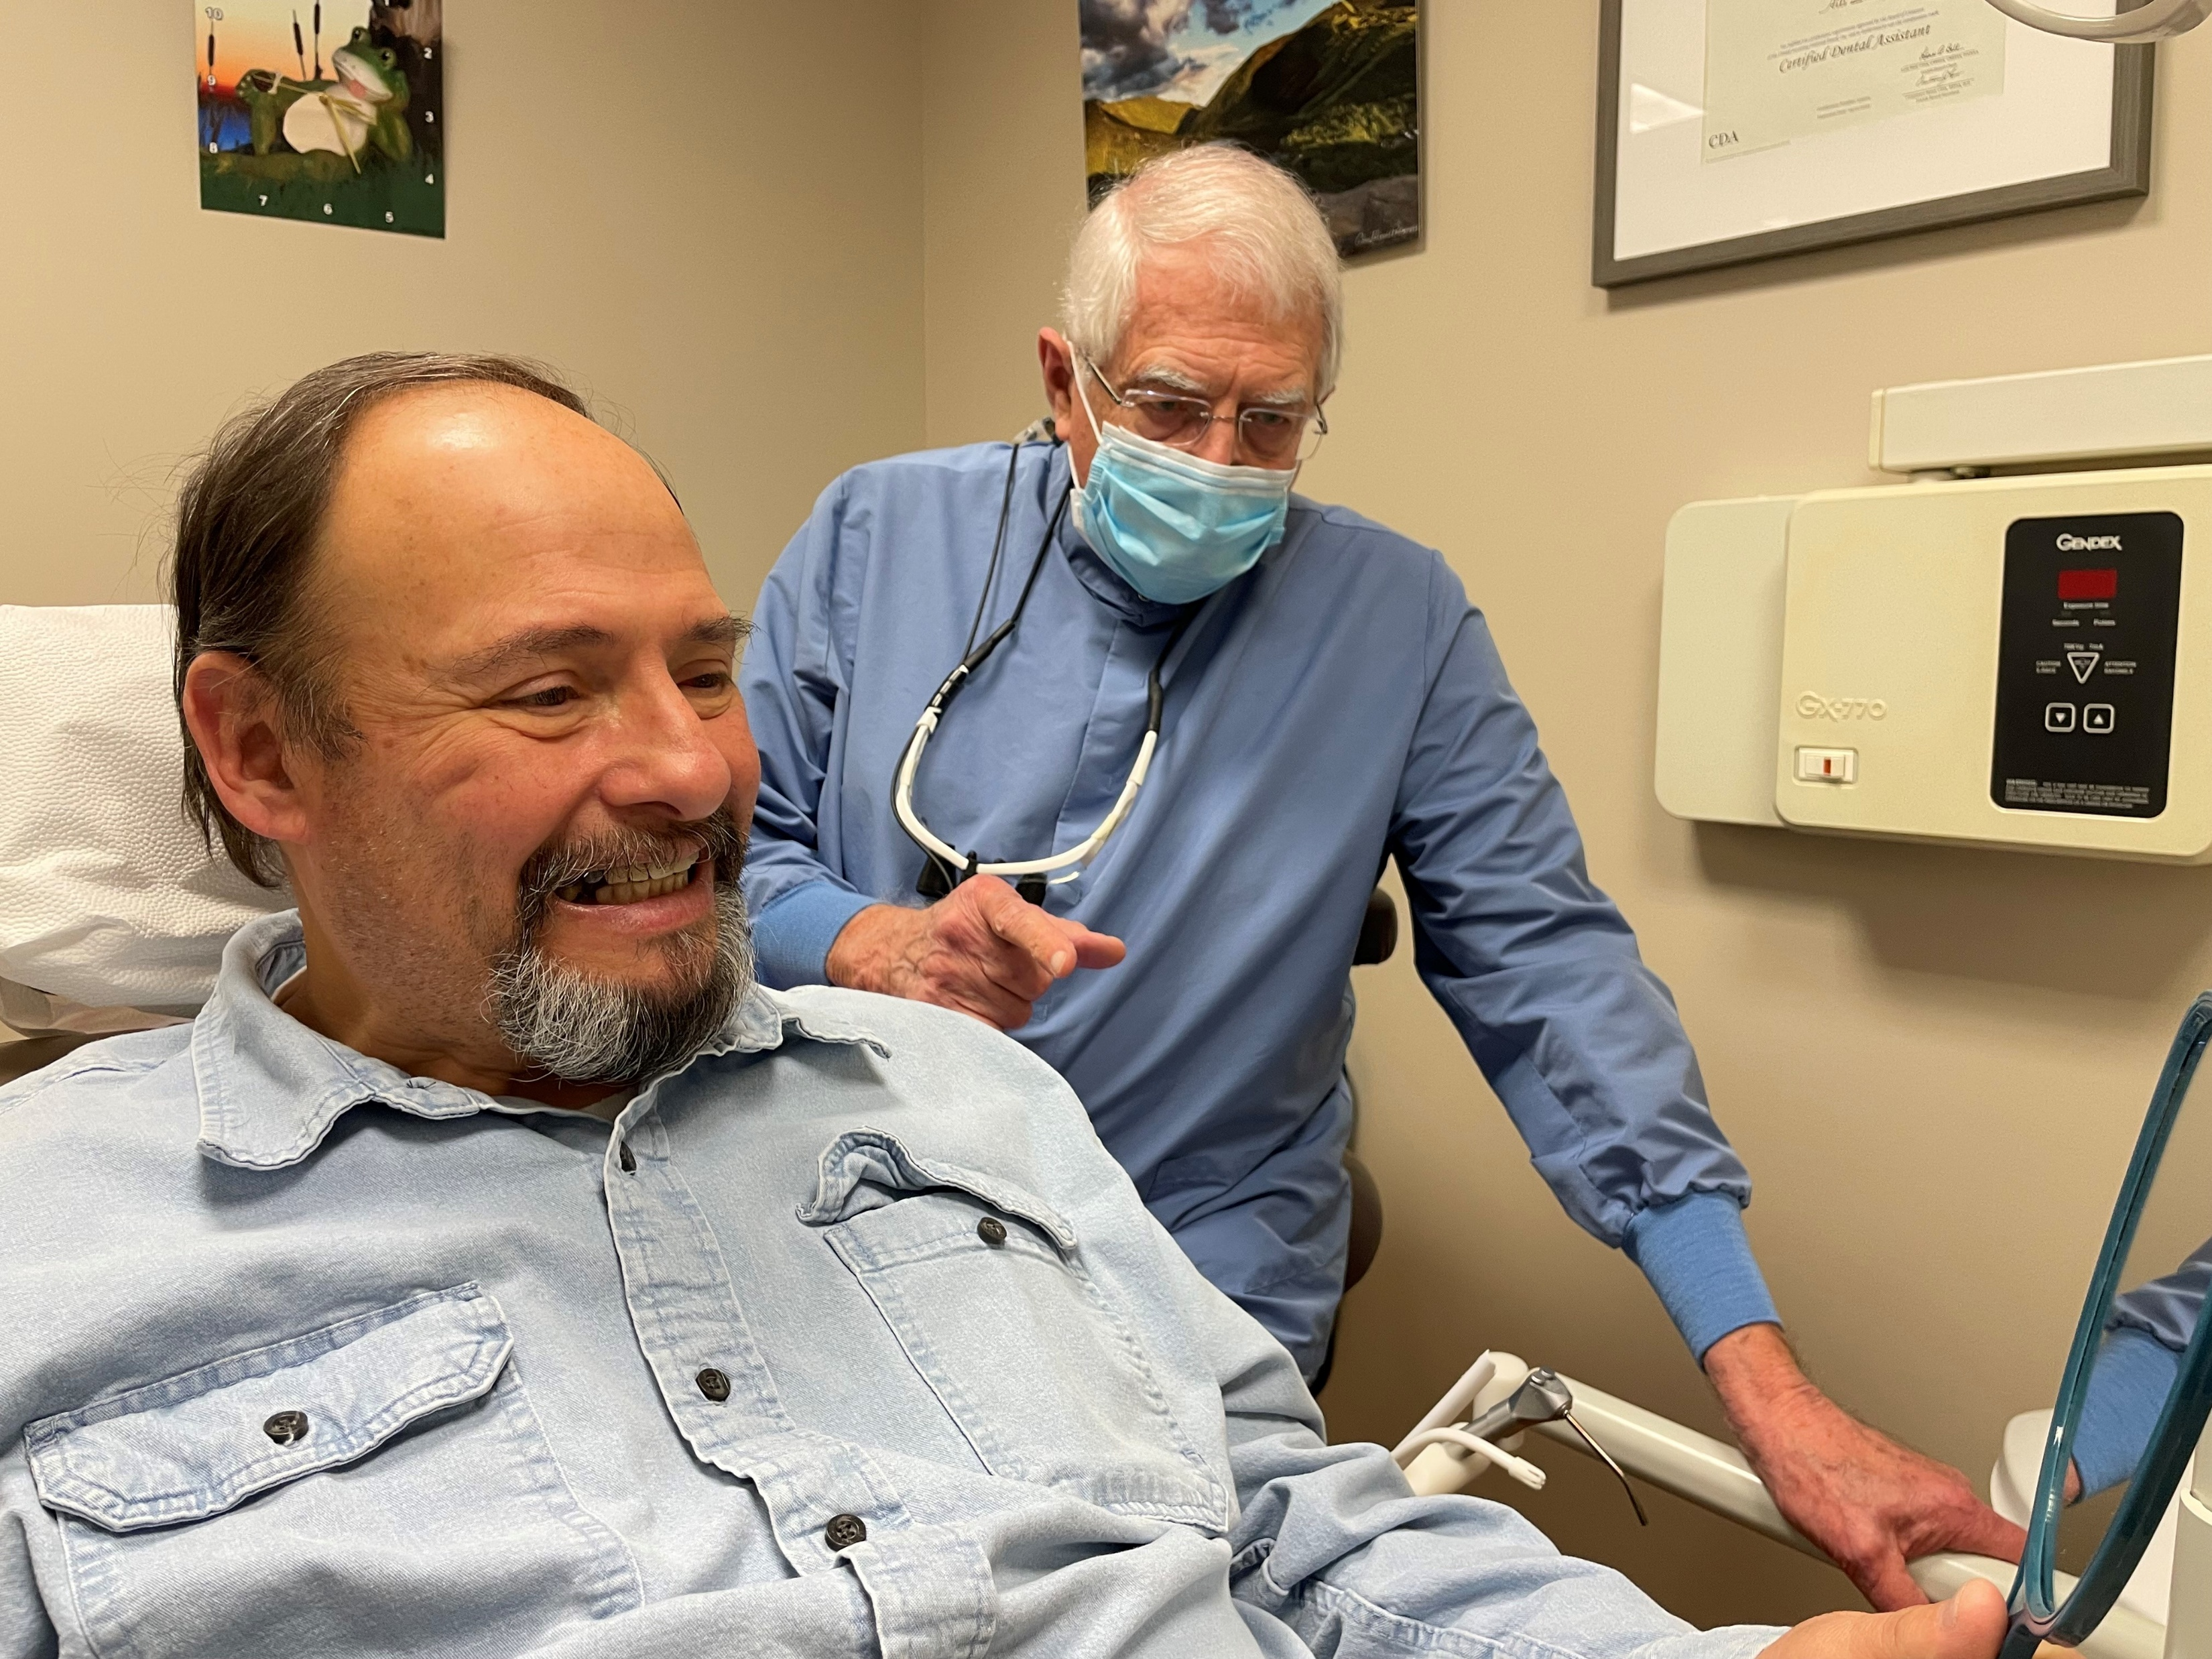
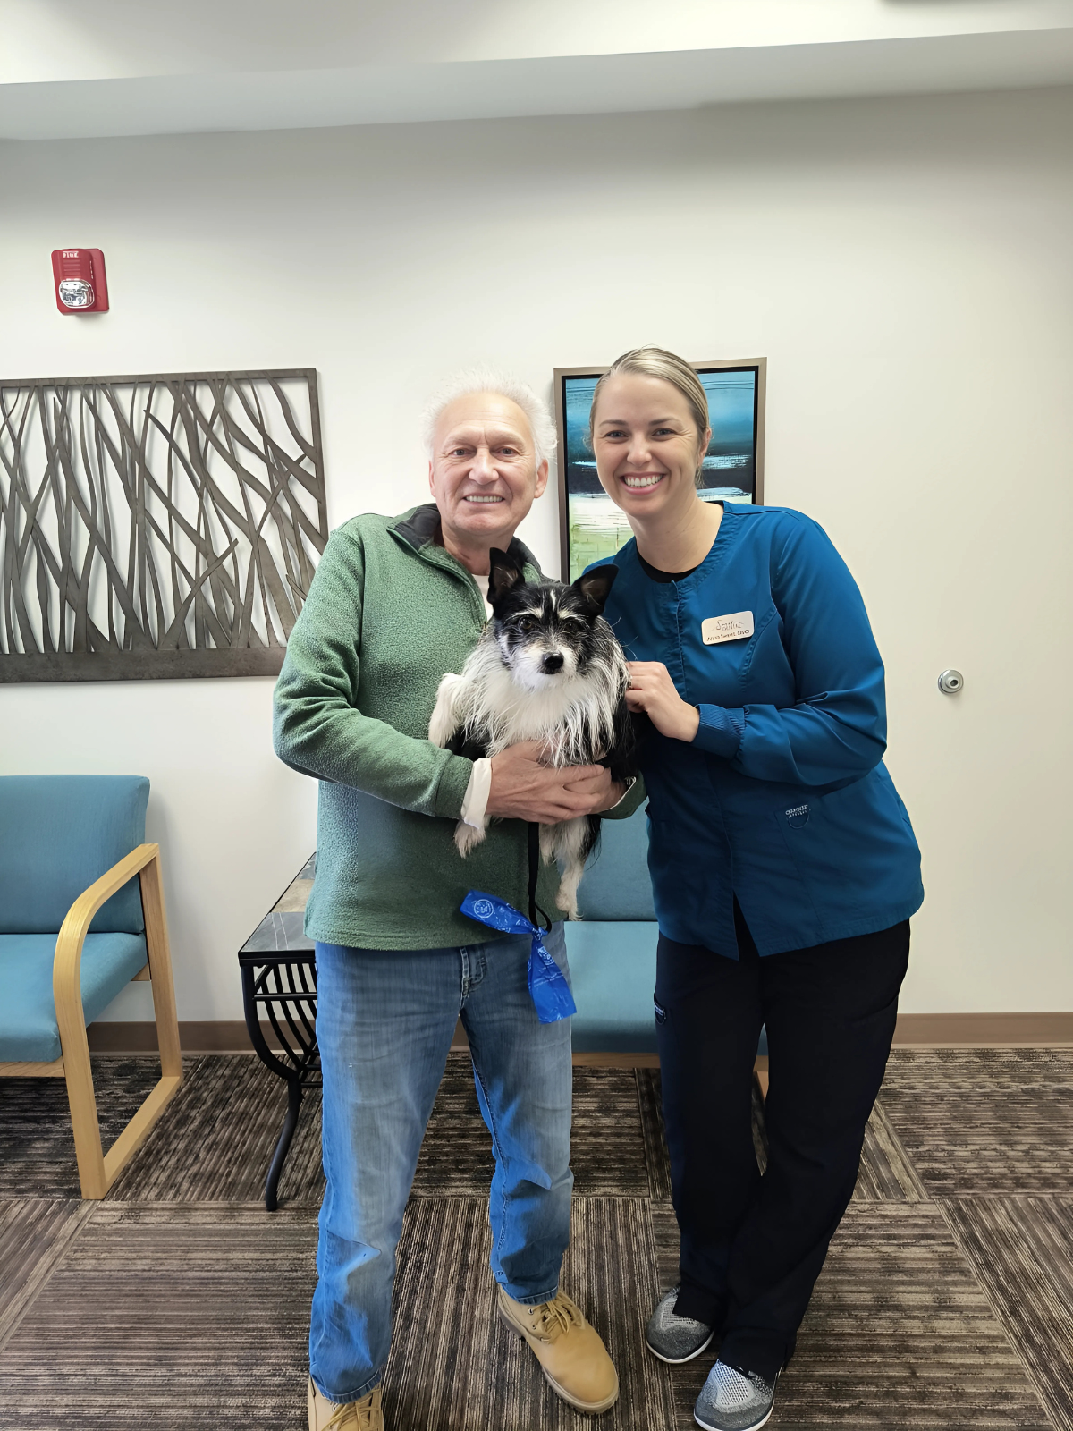
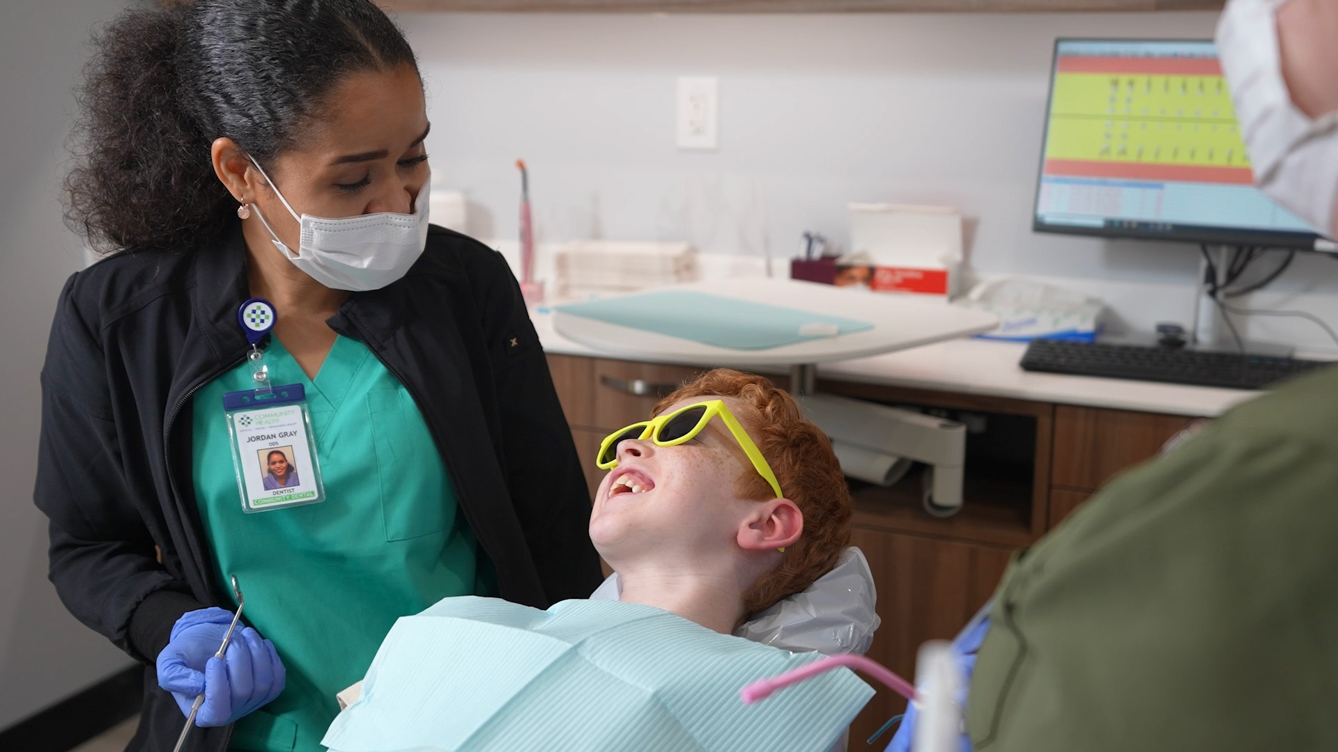
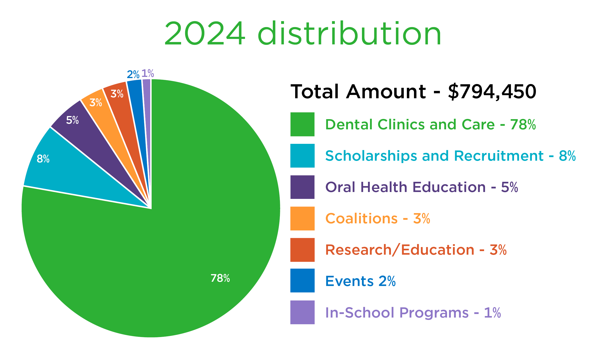
Community support
The Northeast Delta Dental Foundation supports oral health initiatives throughout Maine,
New Hampshire and Vermont. In 2024, the Foundation donated more than $794,000 to oral health programs. In addition, Northeast Delta Dental supports organizations and initiatives important to the communities throughout our three states through a corporate grant application process. Grants totaled $6.4 million in 2023 and exceeded $8.2 million in 2024.
Slide 6

Slide 8
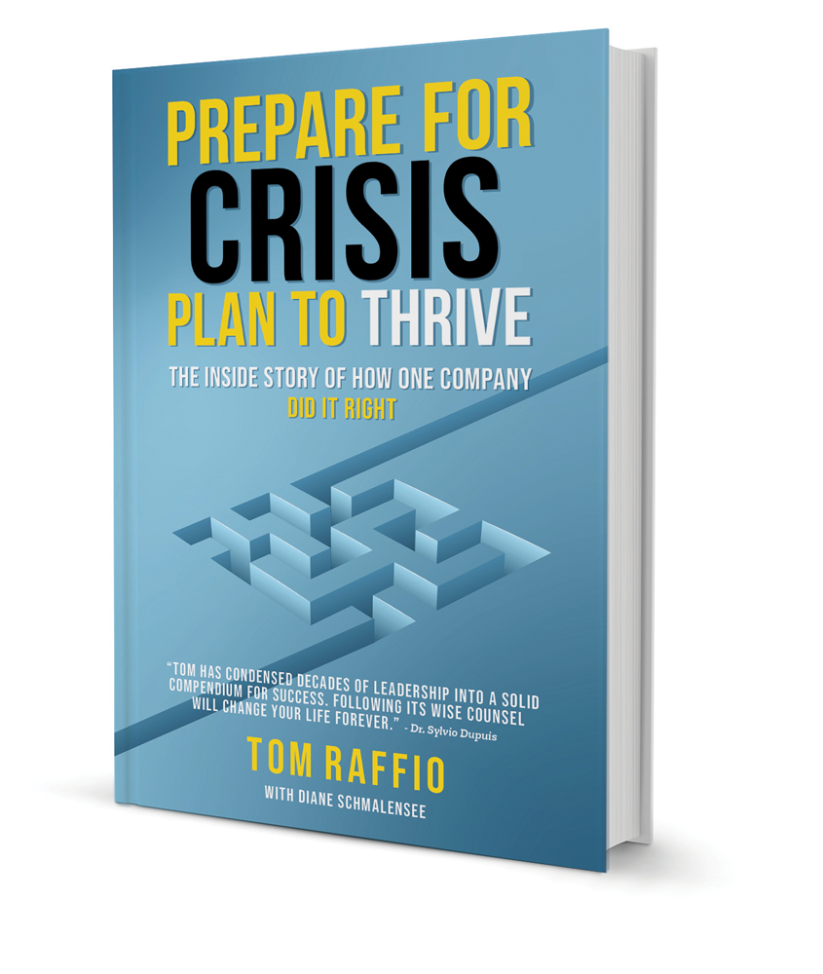
Resilience
COVID-19 response
  $7 million in financial relief to oral health care providers
  $500,000 to nonprofit organizations providing dental care access
  $700,000 to producers/brokers in financial relief commissions
  $18.8 million in returned and reduced premium to customers
  10 days of emergency relief time to employees
Slide 7

Slide 9
What have we learned from Baldrige?
It’s a race without a finish line.
Teamwork
Quality
Integrity
Commitment
Slide 8

Slide 10

It all comes together to fulfill our mission…

